Slide 1
Ethical perspectives in Business Organizations
Presented by
IBRAHIM KHALIL-Bsse0804
Tulshi Chandra das-bsse0811
Maloy kanti sarker-bsse0834
Presented to
Rezvi shahariar
Assistant professor,
Institute of information technology

Slide 2
Outline
Introduction
Purpose
Methodology
Findings
Summery

Slide 3

Introduction
Now-a-days a major issue in organizations
Issues are related to the employees and managers
Each organization give a high priority on ethical issues
The research mainly based on the organizations of Bangladesh

Slide 4
Purpose
to identify how the code of ethics help the organization to maintain business policy.
analyze how the ethical behavior is treated in organizations.
assess the value of ethical behavior in decision making in organizations
rummage how managers behave with their employees in organizations
identify how ethical issues varies organizations to organizations.

Slide 5


Methodology
Direct interview
Online response to questions

Slide 6
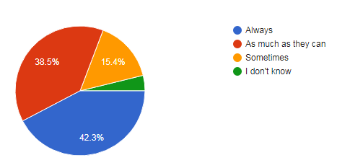
Findings
Rate of high ethical standard of managers

Slide 7
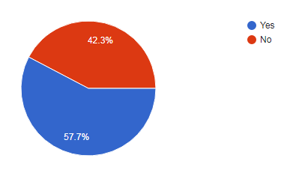
Findings(Cont.)
Rate of green computing in organizations

Slide 8
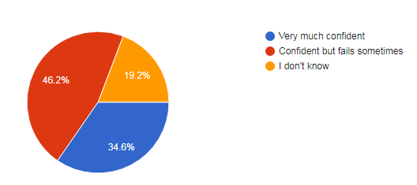
Findings(Cont.)
Whistle blowing management

Slide 9
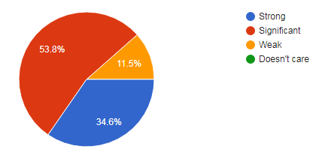
Findings(Cont.)
Software piracy prevention

Slide 10
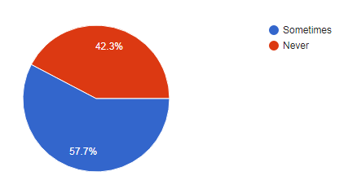
Findings(Cont.)
Different behavior in plural groups

Slide 11
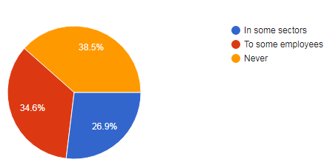
Findings(Cont.)
Rate of nepotism

Slide 12
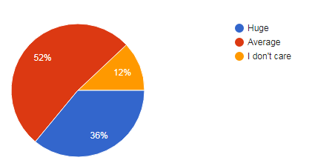
Findings(Cont.)
Analysis on pressure felt by employees

Slide 13
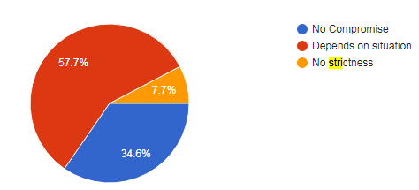
Findings(Cont.)
Strictness on unethical behavior

Slide 14
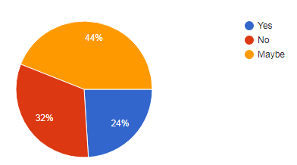
Findings(Cont.)
Rate of created issues for whistleblowing

Slide 15
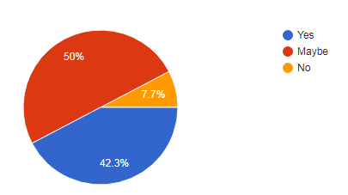
Findings(Cont.)
Rate of freely sharing data

